Slide 1
The Emotional Effect of Color
By: Alejandro Theodosiou

Slide 2
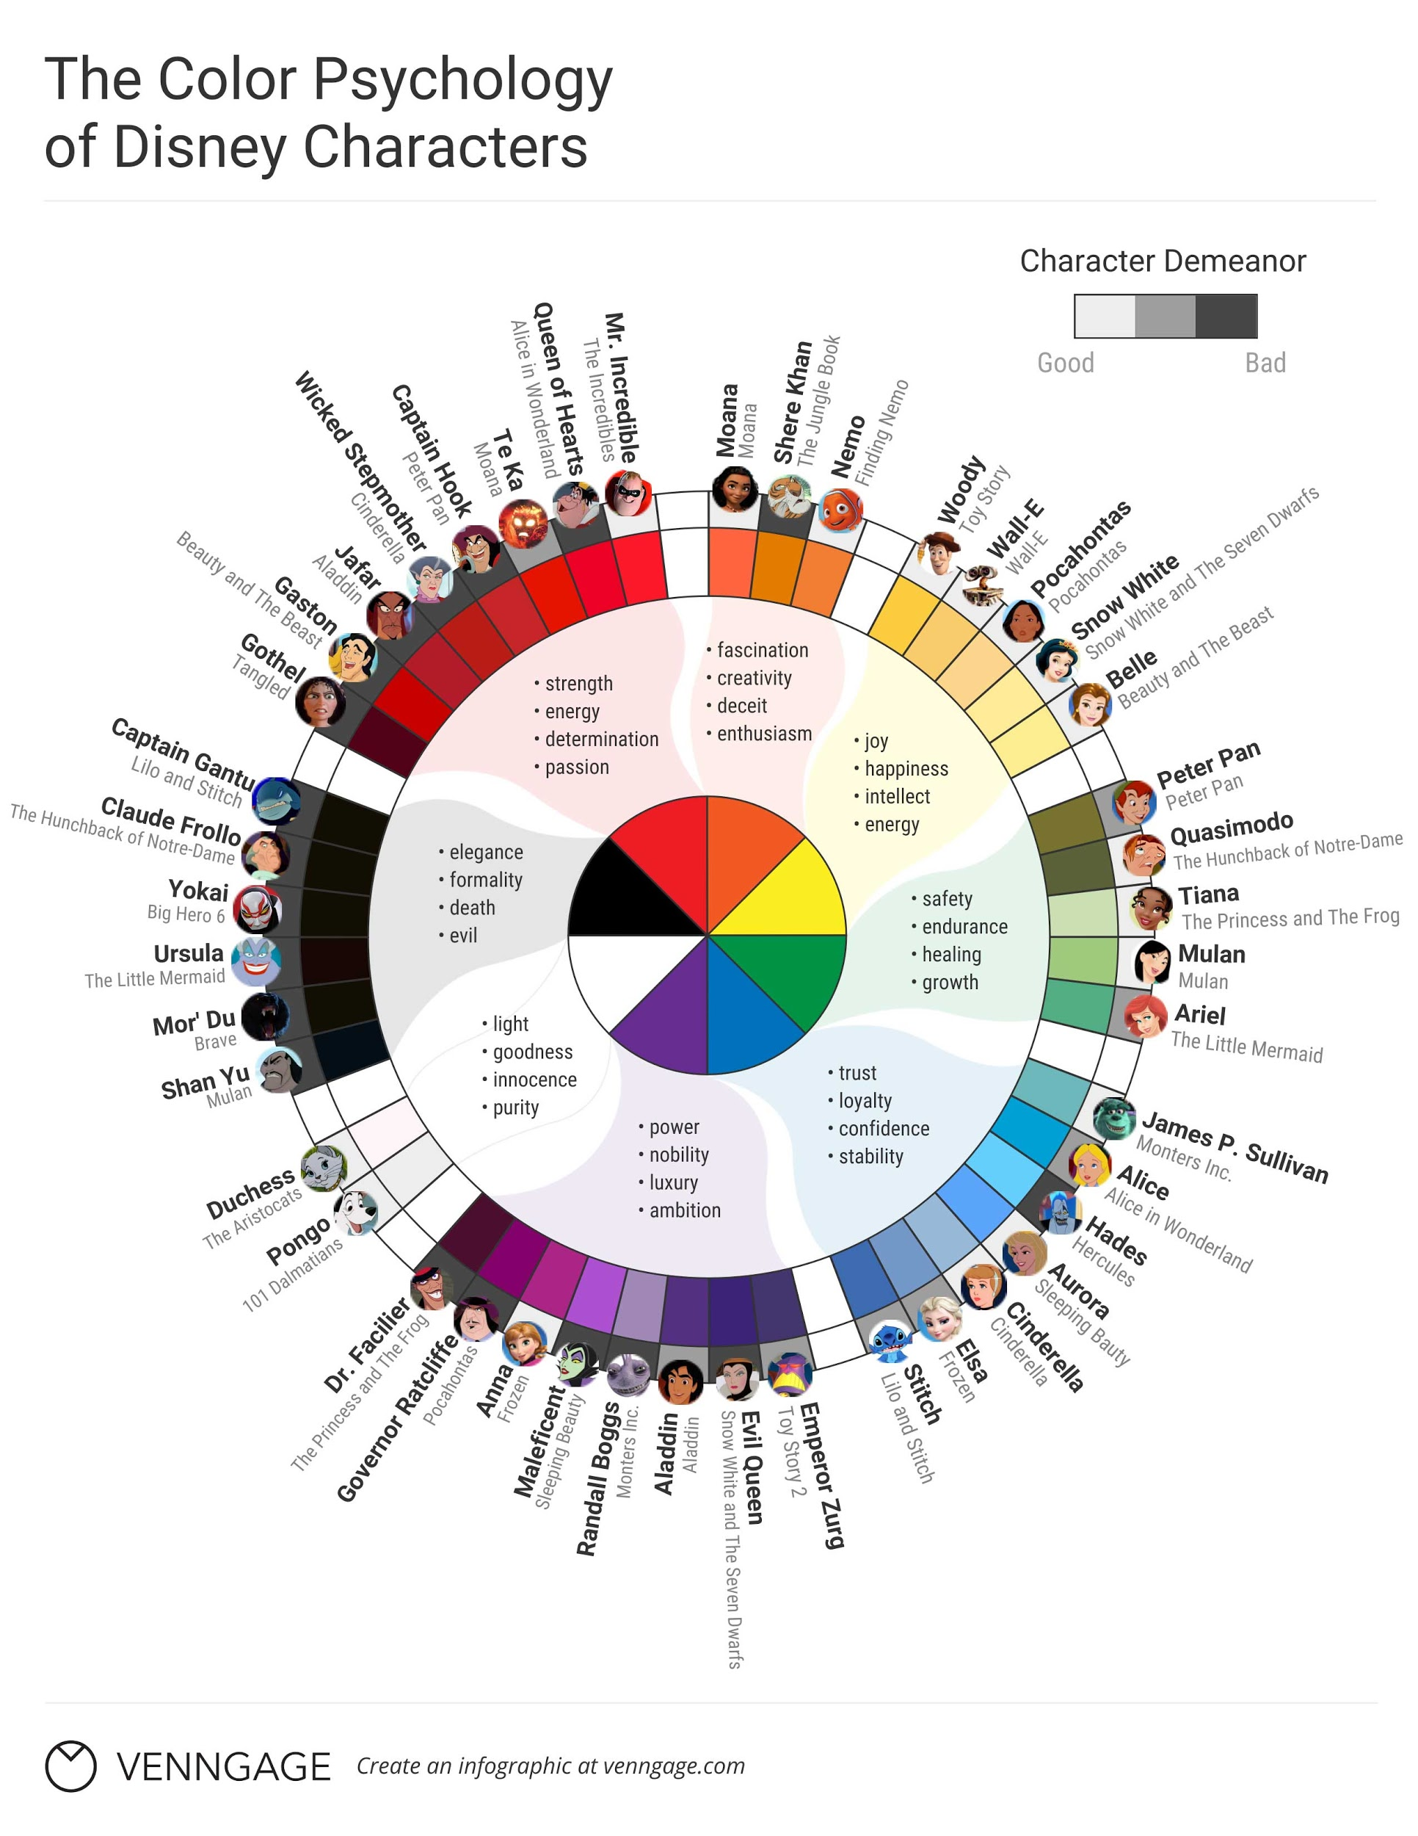

Slide 3
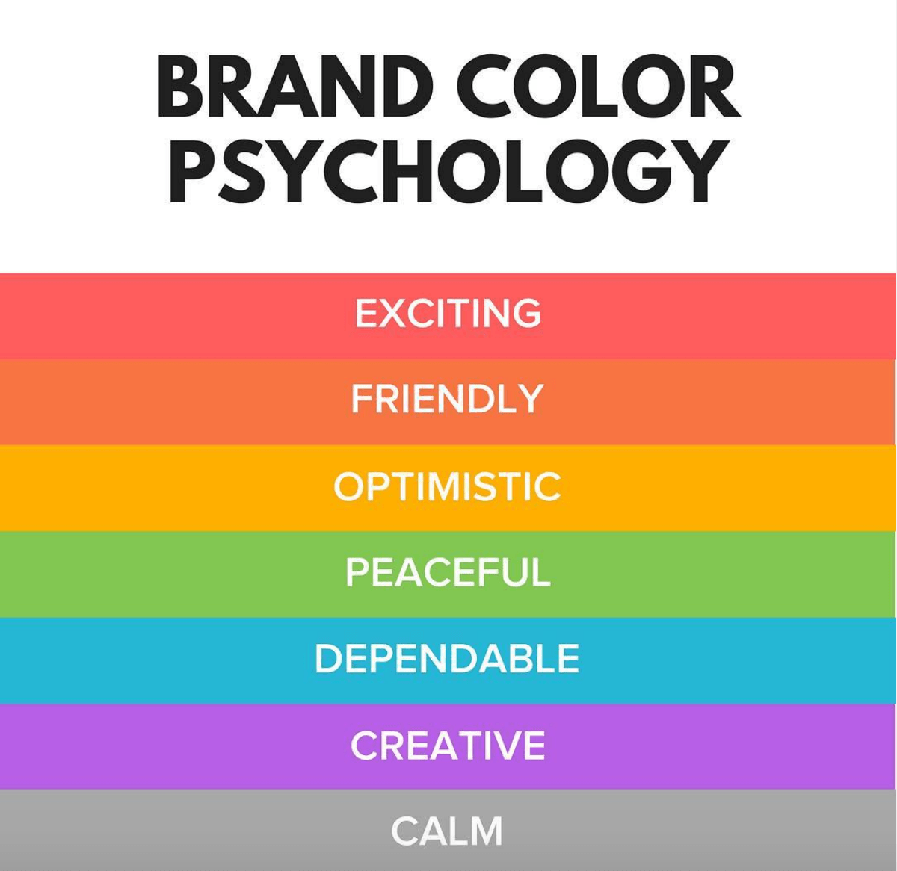
Colors emode different personality traits.

Slide 4
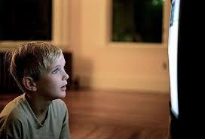
Colors
influence perception
and cause emotions

Slide 5
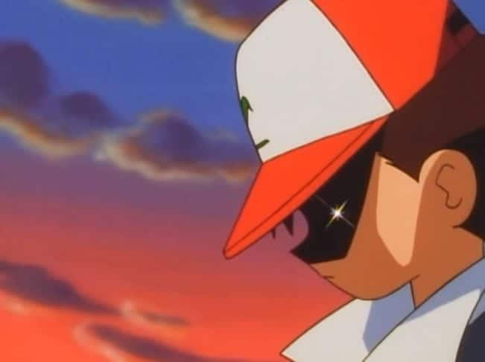
This especially happens when watching cartoons.
Artists can change the mood of a scene by using some dominant colors or the opposite ones.

Slide 6
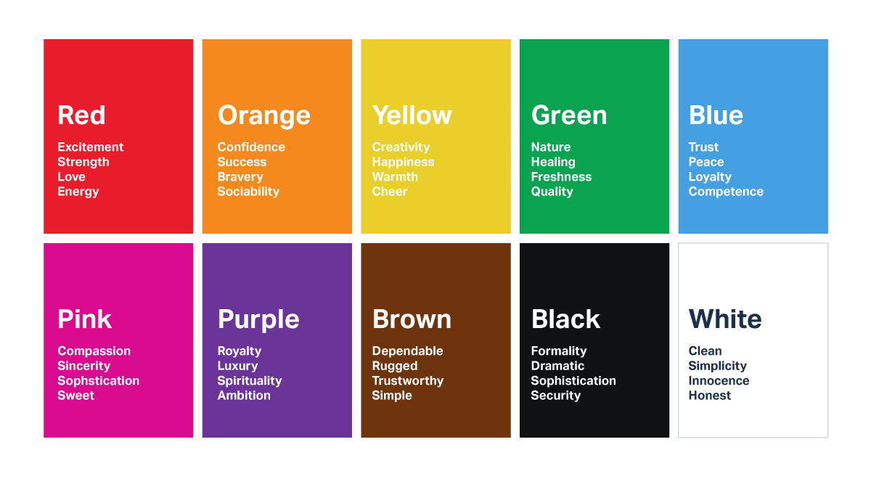

Slide 7
PIXAR’S “UP”
Let’s diagnose the movie with the color chart.
Let’s also diagnose the scenes with our emotions.

Slide 8
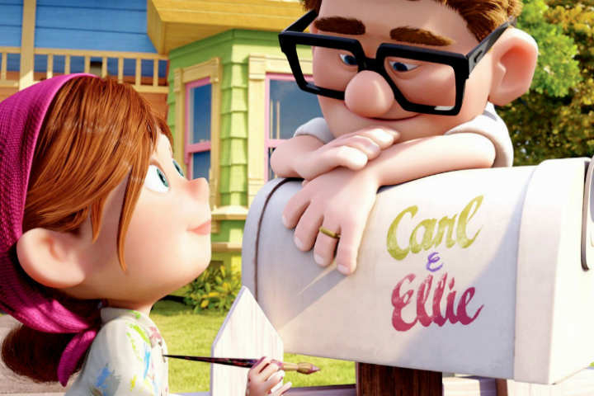

Slide 9
A lot of color is shown when Carl & Ellie are young and deeply in love.
Carl’s name is in green which expresses his peaceful state.
While Ellie is in pink showing she’s excited for their future together.

Slide 10
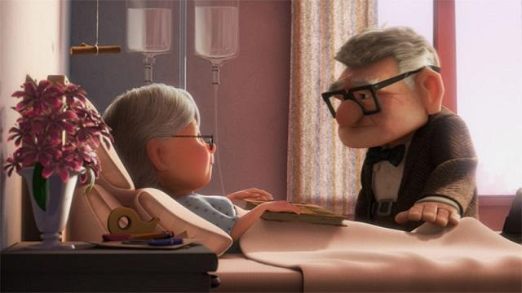

Slide 11
In this scene Carl & Ellie are in a blue and pink room but the colors are not bright, but dull.
This clip makes me feel the sadness they’re experiencing.

Slide 12
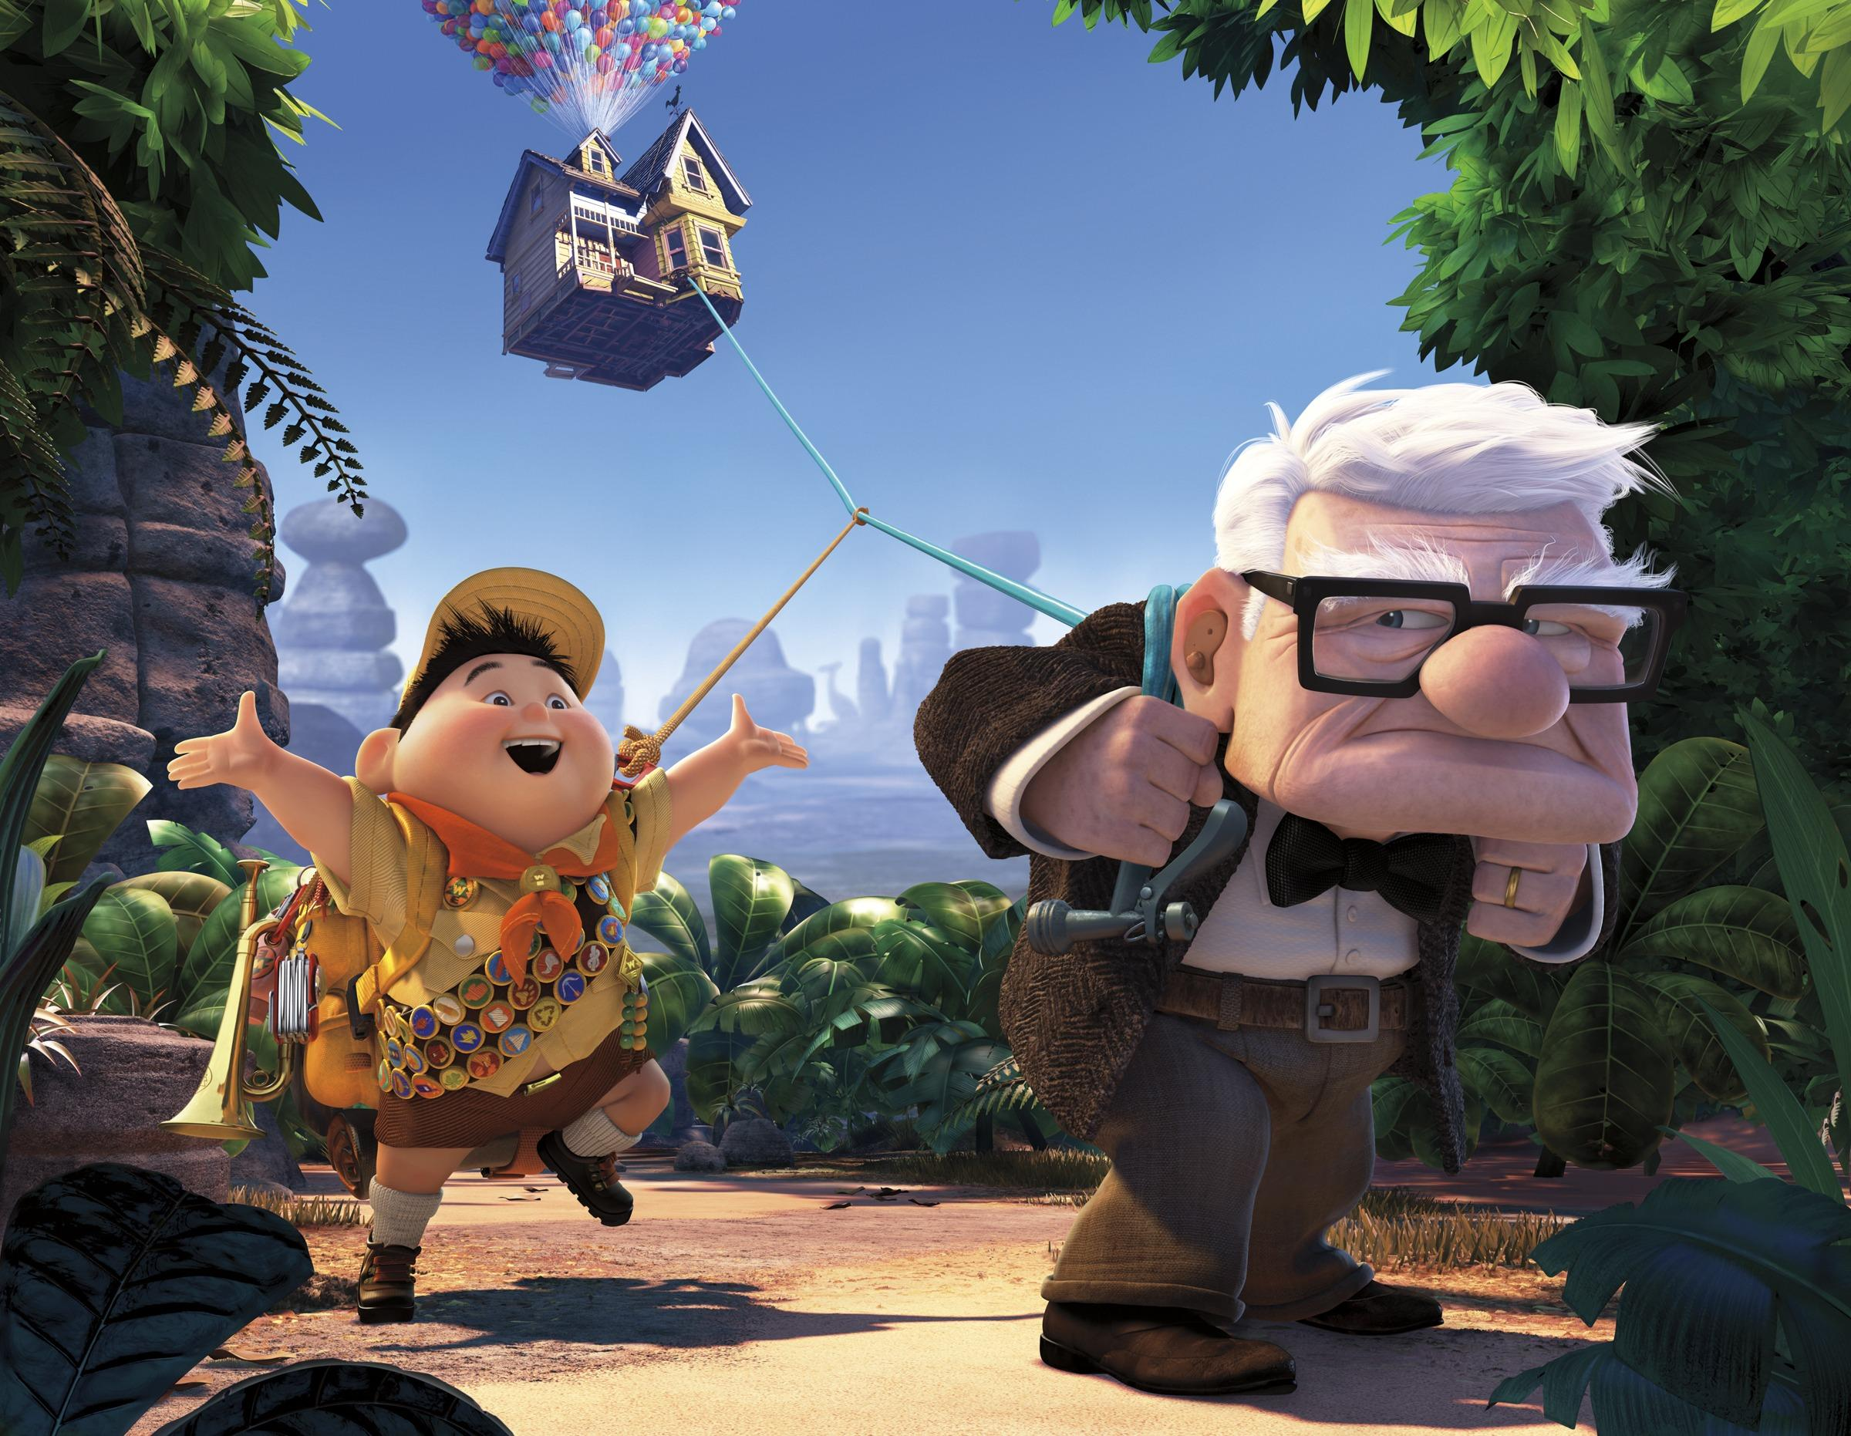
In Pixar’s “Up”, joyful Russell, wears yellow. While moody Carl wears brown.

Slide 13
It’s important to understand how your feelings can be affected by the images you see on screen.
Artist will use color to convey feelings. But it’s also important to follow facial expressions.

Slide 14
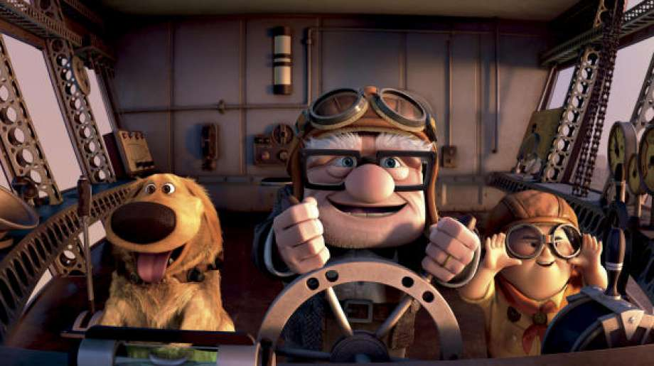

Slide 15
Actions speaks louder than words.
In this clip the colors continue to be gray, but the smiles on the characters show you how to feel.

Slide 16
Be creative!!!
Use the color chart to express what Emotions you want to portray with your artwork!

